Slide 1
To-Do List A task management App
The Best management tool for Everybody.

Slide 2
Prepared by :
MD. Meharab Latif
ID : L1A-C-30-0-38
District : Dhaka
Mobile : +8801992647205

Slide 3
Outline :
Problem Statement
Technology
Effect of the problems
Project-screenshot
Supporting information
Possible Upgradation
Project objective
Introducing : To-Do List App

Slide 4
Problem Statement
We are living in 21 century . People are always busy by doing lots of works. Because of the pressure of work people often forgot many less important tasks that cause a major unbalance to their daily life or even worse!
e.g. pay the electric bill, pick up children from school/day-care, attending social events etc.

Slide 5
Effect of the problems
Social life
01
02
Family
03
Work Place
etc.

Slide 6



Supporting information 01 :
List of diseases of memory loss :
Acquired Brain Injury (ABI)
Agnosia.
Alzheimer's disease.
Amnesia.
Dementia.
Hyperthymestic syndrome.
Huntington's disease.
Parkinson's disease.
etc.

Slide 7
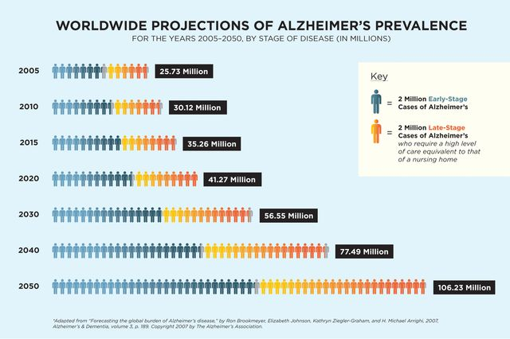
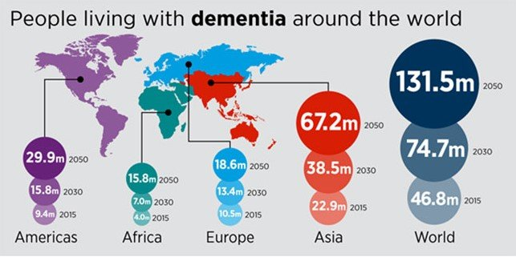
Supporting information 02 :
Statistics on DEMENTIA ( memory loss disease )
around the world
100%
80%
60%
40%
20%
0%
Q1
Q2
Q3
Q4
2015
100%
80%
60%
40%
20%
0%
Growth of ALZHIMER ( memory loss disease )
around the world
Q1
Q2
Q3
Q4
2017

Slide 8
Project objective
Remaind Tasks
Organize Tasks
Store Tasks
Category Based Tasks

Slide 9
Introducing : To-Do List App
To-Do List is an iOS app that is designed to manage our daily base tasks. This application basically focus on
Daily based tasks
Special based tasks
Category based tasks

Slide 10
Technology
Software : Xcode 9 & Simulator
Hardware : Apple Macbook Air & Apple Macbook Pro

Slide 11
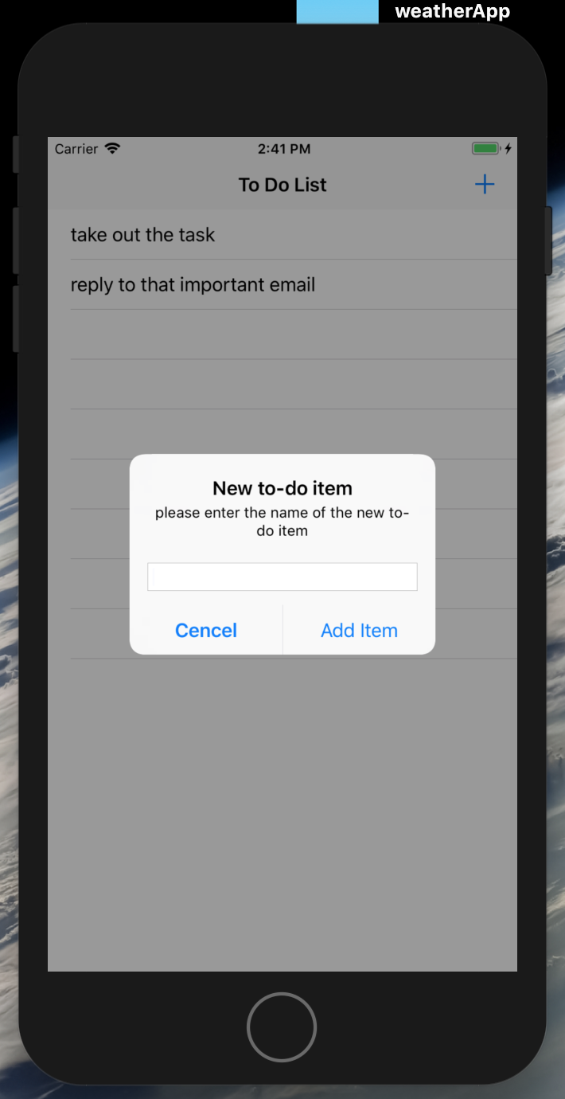

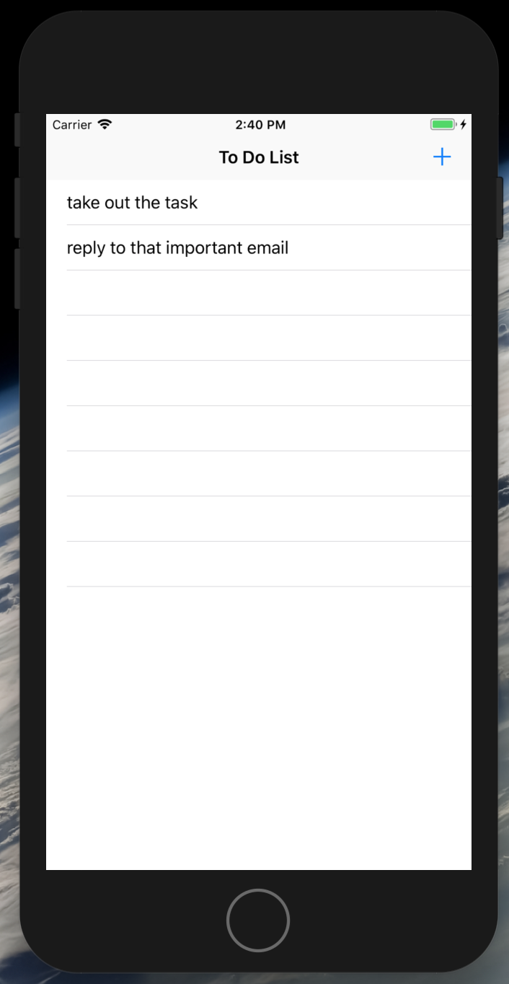
Project-screenshot :
Alert view poped up
Click Add button

Slide 12
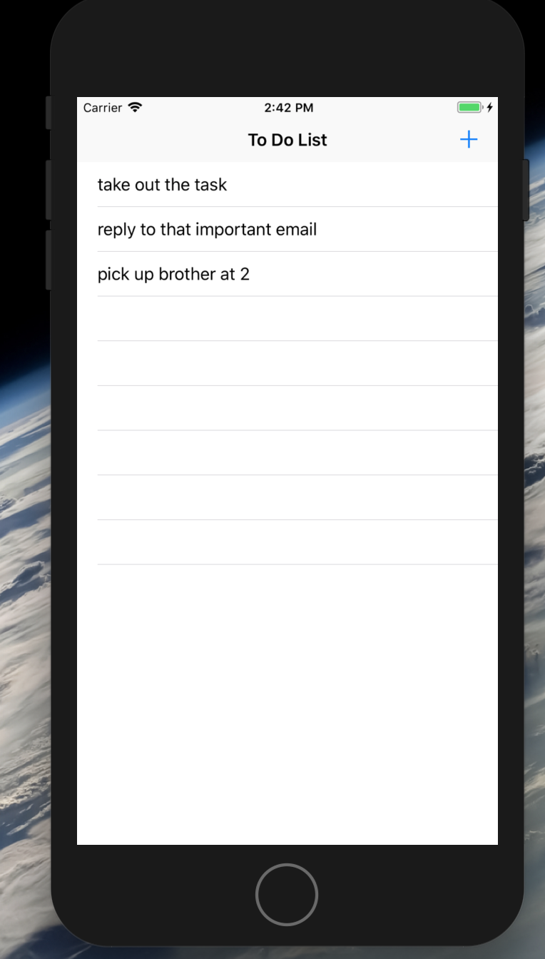
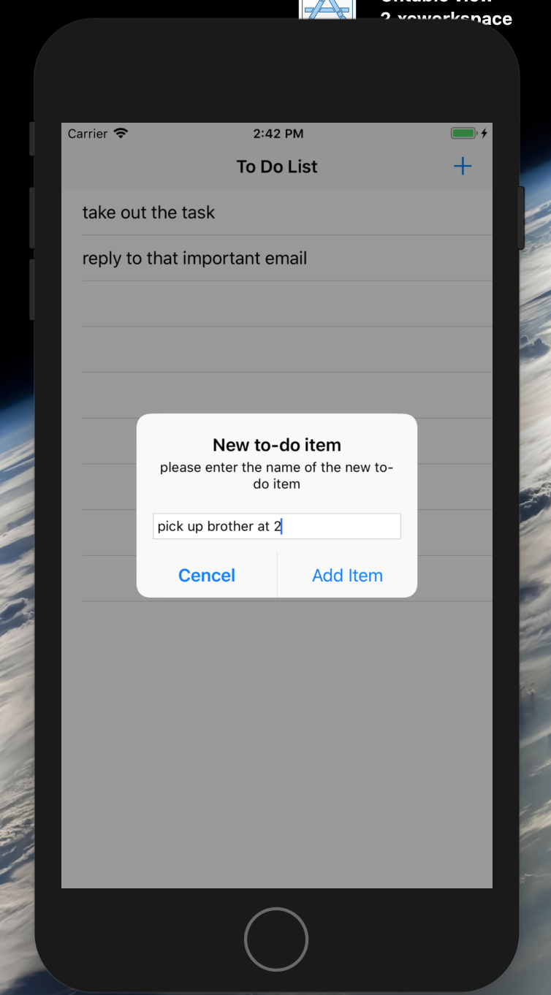
Project-screenshot :
Text shown in the row
Write task in the box & tap add item

Slide 13
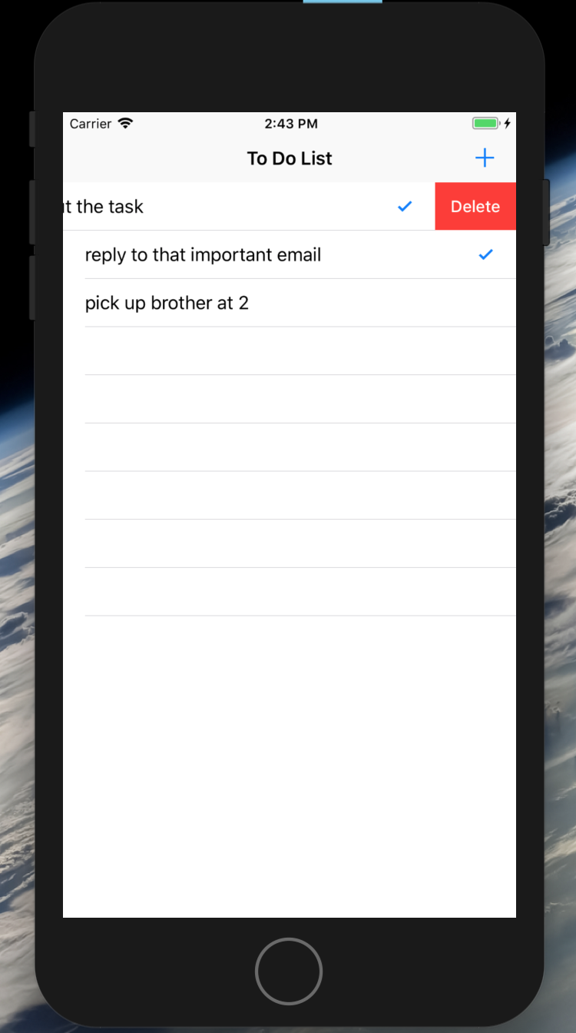
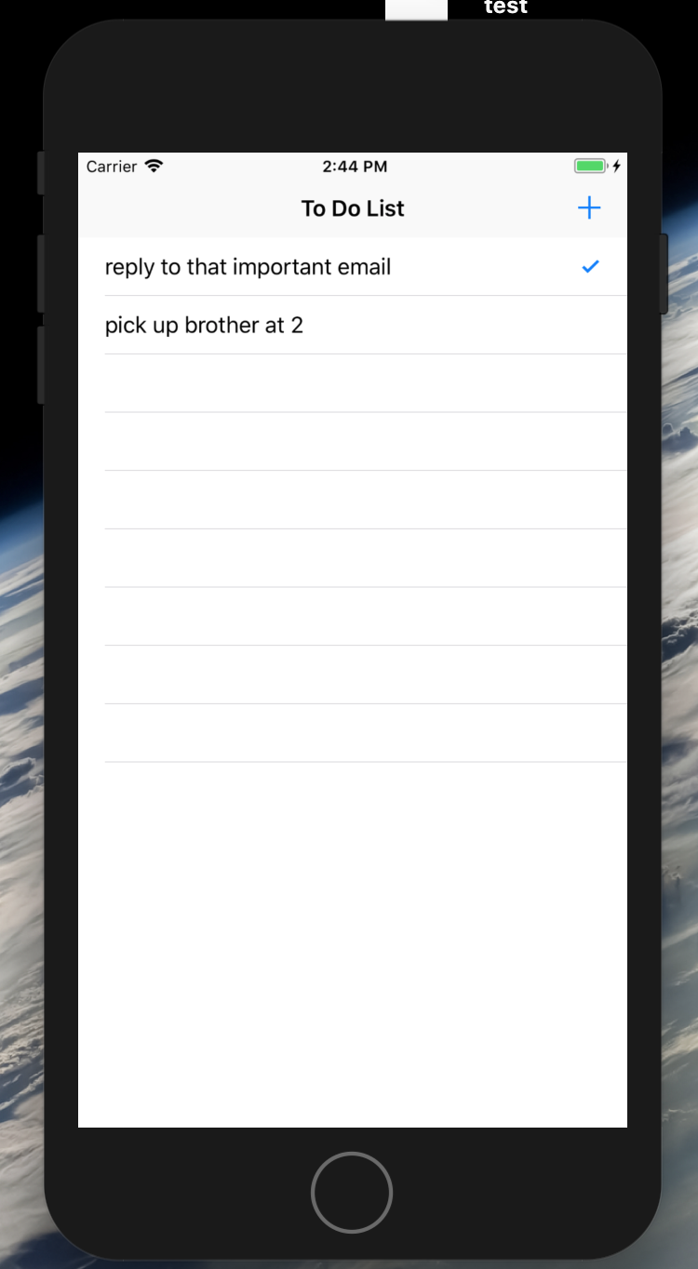
Project-screenshot :
Tap the row to add checkmark if the task is done
Swipe right to left to delete the task

Slide 14
Possible Upgradation:
This app can be developed and increase the functions
By adding
Reminder system
Map system to locate the place of the task
Date system
Artificial intelligence ( e.g. SIRI ) to calculated the nearest task using current location
Priority system to do the urgent task first
Mechine Learning to get the optimal solution

Slide 15


Thank you!
The End

